Slide 1
Cloud Security and Privacy

Slide 2
Minimize Loss of Control: Monitoring
Cloud consumer needs situational awareness for critical applications
When underlying components fail, what is the effect of the failure to the mission logic
What recovery measures can be taken (by provider and consumer)
Requires an application-specific run-time monitoring and management tool for the consumer
The cloud consumer and cloud provider have different views of the system
Enable both the provider and tenants to monitor the components in the cloud that are under their control
Notes:
When the underlying components fail in the cloud, the effect of the failures to the mission logic needs to be known so that correct recovery measures can be performed. We propose an application-specific run-time monitoring and management tool. With this tool, the application logic can remain on the consumer’s host computer. This allows the consumer to centrally monitor all aspects of the application as well as data flow. Since all outputs from underlying services are sent to the application logic, any data incompatibility between services is not an issue. The capabilities of the run-time monitoring and management tool are as follows: 1) Enable application user to determine the status of the cloud resources that may be used to run the application (across multiple clouds), 2) Enable application user to determine the real-time security posture and situational awareness of the application, 3) Provide the application user with the ability to move user’s application (or part of it) to another site (other VM in same cloud or different cloud altogether), 4) Provide the application user with the ability to change the application logic on the fly, 5) Provide communicate capabilities with cloud providers. There are a few cloud vendors such as NimSoft [41] and Hyperic [42] that provide application-specific monitoring tools that provide some of the above functionality. These monitoring tools may be further enhanced or used in conjunction with other tools to provide the degree of monitoring required. However, any tool that is to be used for military purposes must also receive some type of accreditation and certification procedure.

Slide 3
Minimize Loss of Control: Monitoring (Cont.)
Provide mechanisms that enable the provider to act on attacks he can handle.
infrastructure remapping (create new or move existing fault domains)
shutting down offending components or targets (and assisting tenants with porting if necessary
Repairs
Provide mechanisms that enable the consumer to act on attacks that he can handle (application-level monitoring).
RAdAC (Risk-adaptable Access Control)
VM porting with remote attestation of target physical host
Provide ability to move the user’s application to another cloud

Slide 4
Minimize Loss of Control: Utilize Different Clouds
The concept of ‘Don’t put all your eggs in one basket’
Consumer may use services from different clouds through an intra-cloud or multi-cloud architecture
Propose a multi-cloud or intra-cloud architecture in which consumers
Spread the risk
Increase redundancy (per-task or per-application)
Increase chance of mission completion for critical applications
Possible issues to consider:
Policy incompatibility (combined, what is the overarching policy?)
Data dependency between clouds
Differing data semantics across clouds
Knowing when to utilize the redundancy feature (monitoring technology)
Is it worth it to spread your sensitive data across multiple clouds?
Redundancy could increase risk of exposure
Notes:
Differering data semantics example: does a data item labeled secret in one cloud have the same semantics as another piece of data also labeled secret in a different cloud?

Slide 5
Minimize Loss of Control: Access Control
Many possible layers of access control
E.g. access to the cloud, access to servers, access to services, access to databases (direct and queries via web services), access to VMs, and access to objects within a VM
Depending on the deployment model used, some of these will be controlled by the provider and others by the consumer
Regardless of deployment model, provider needs to manage the user authentication and access control procedures (to the cloud)
Federated Identity Management: access control management burden still lies with the provider
Requires user to place a large amount of trust on the provider in terms of security, management, and maintenance of access control policies. This can be burdensome when numerous users from different organizations with different access control policies, are involved
Notes:
In cloud computing (as well as other systems), there are many possible layers of access control. For example, access to the cloud, access to servers, access to services, access to databases (direct and queries via web services), access to VMs, and access to objects within a VM. Depending on the deployment model used, some of these will be controlled by the provider and others by the consumer.
For example, Google Apps, a representative SaaS Cloud controls authentication and access to its applications, but users themselves can control access to their documents through the provided interface to the access control mechanism. In IaaS type approaches, the user can create accounts on its virtual machines and create access control lists for these users for services located on the VM.
Regardless of the deployment model, the provider needs to manage the user authentication and access control procedures (to the cloud). While some providers allow federated authentication – enabling the consumer-side to manage its users, the access control management burden still lies with the provider. This requires the user to place a large amount of trust on the provider in terms of security, management, and maintenance of access control policies. This can be burdensome when numerous users from different organizations with different access control policies, are involved. This proposal focuses on access control to the cloud. However, the concepts here could be applied to access control at any level, if deemed necessary. We propose a way for the consumer to manage the access control decision-making process to retain some control, requiring less trust of the provider.
Approach:
This approach requires the client and provider to have a pre-existing trust relationship, as well as a pre-negotiated standard way of describing resources, users, and access decisions between the cloud provider and consumer. It also needs to be able to guarantee that the provider will uphold the consumer-side’s access decisions. Furthermore, we need to show that this approach is at least as secure as the traditional access control model.
This approach requires the data owner to be involved in all requests. Therefore, frequent access scenarios should not use this method if traffic is a concern. However, many secure data outsourcing schemes require the user to grant keys/certificates to the query side, so that every time the user queries a database, the owner needs to be involved. Therefore, not much different than that so may not be a problem.

Slide 6
Minimize Loss of Control: Access Control (Cont.)
Consumer-managed access control
Consumer retains decision-making process to retain some control, requiring less trust of the provider (i.e. PDP is in consumer’s domain)
Requires the client and provider to have a pre-existing trust relationship, as well as a pre-negotiated standard way of describing resources, users, and access decisions between the cloud provider and consumer. It also needs to be able to guarantee that the provider will uphold the consumer-side’s access decisions.
Should be at least as secure as the traditional access control model.
Facebook and Google Apps do this to some degree, but not enough control
Applicability to privacy of patient health records

Slide 7
Minimize Loss of Control: Access Control
Cloud Provider in Domain A
Cloud Consumer in Domain B
1. Authn request
IDP
PEP
(intercepts all
resource
access requests
from all client
domains)
3. Resource request (XACML Request) + SAML assertion
2. SAML Assertion
.
.
.
4. Redirect to domain of resource owner
PDP
for cloud
resource
on Domain A
5. Retrieve policy
for specified resource
resources
ACM
(XACML
policies)
7. Send signed and encrypted ticket
6. Determine whether user can access
specified resource
7. Create ticket for grant/deny
8. Decrypt and verify signature
9. Retrieve capability from ticket
10. Grant or deny access based on capability

Slide 8






Minimize Loss of Control: IDM Motivation
User on Amazon Cloud
Name
E-mail
Password
Billing Address
Shipping Address
Credit Card
Name
Billing Address
Credit Card
Name
E-mail
Password
Billing Address
Shipping Address
Credit Card
Name
E-mail
Shipping Address
Name
E-mail
Shipping Address

Slide 9
Minimize Loss of Control: IDM Identity in the Cloud
User on Amazon Cloud
Name
E-mail
Password
Billing Address
Shipping Address
Credit Card
Name
Billing Address
Credit Card
Name
E-mail
Password
Billing Address
Shipping Address
Credit Card
Name
E-mail
Shipping Address
Name
E-mail
Shipping Address

Slide 10
Minimize Loss of Control: IDM Present IDMs
IDM in traditional application-centric IDM model
Each application keeps track of identifying information of its users.
Existing IDM Systems
Microsoft Windows CardSpace [W. A. Alrodhan]
OpenID [http://openid.net]
PRIME [S. F. Hubner]
These systems require a trusted third party and
do not work on an untrusted host.
If Trusted Third Party is compromised, all the identifying information of the users is also compromised
[Latest: AT&T iPad leak]

Slide 11
Minimize Loss of Control: IDM Issues in Cloud Computing
Cloud introduces several issues to IDM
Users have multiple accounts associated with multiple service providers.
Lack of trust
Use of Trusted Third Party is not an option
Cloud hosts are untrusted
Loss of control
Collusion between Cloud Services
Sharing sensitive identity information between services can lead to undesirable mapping of the identities to the user.
IDM in Cloud needs to be user-centric

Slide 12
Minimize Loss of Control: IDM Goals of Proposed User-Centric IDM for the Cloud
Authenticate without disclosing identifying information
Ability to securely use a service while on an untrusted host (VM on the cloud)
Minimal disclosure and minimized risk of disclosure during communication between user and service provider (Man in the Middle, Side Channel and Correlation Attacks)
Independence of Trusted Third Party

Slide 13
Minimize Loss of Control: IDM Approach - 1
IDM Wallet:
Use of AB scheme to protect PII from untrusted hosts.
Anonymous Identification:
Use of Zero-knowledge proofing for authentication of an entity without disclosing its identifier.

Slide 14
Minimize Loss of Control: IDM Components of Active Bundle (Approach – 1)
Identity data: Data used during authentication, getting service, using service (i.e. SSN, Date of Birth).
Disclosure policy: A set of rules for choosing Identity data from a set of identities in IDM Wallet.
Disclosure history: Used for logging and auditing purposes.
Negotiation policy: This is Anonymous Identification, based on the Zero Knowledge Proofing.
Virtual Machine: Code for protecting data on untrusted hosts. It enforces the disclosure policies.

Slide 15
Minimize Loss of Control: IDM Anonymous Identification (Approach – 1)
Anonymous Identification
(Shamir's approach for Credit Cards)
IdP provides Encrypted Identity Information to the user and SP.
SP and User interact
Both run IdP's public function on the certain bits of the Encrypted data.
Both exchange results and agree if it matches.

Slide 16
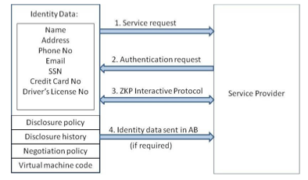
Minimize Loss of Control: IDM Usage Scenario (Approach – 1)

Slide 17
Minimize Loss of Control: IDM Approach - 2
Active Bundle scheme to protect PII from untrusted hosts
Predicates over encrypted data to authenticate without disclosing unencrypted identity data.
Multi-party computing to be independent of a trusted third party

Slide 18
Minimize Loss of Control: IDM Usage Scenario (Approach – 2)
Owner O encrypts Identity Data(PII) using algorithm Encrypt and O’s public key PK. Encrypt outputs CT—the encrypted PII.
SP transforms his request for PII to a predicate represented by function p.
SP sends shares of p to the n parties who hold the shares of MSK.
n parties execute together KeyGen using PK, MSK, and p, and return TKp to SP.
SP calls the algorithm Query that takes as input PK, CT, TKp and produces p(PII) which is the evaluation of the predicate.
The owner O is allowed to use the service only when the predicate evaluates to “true”.

Slide 19
Minimize Loss of Control: IDM Representation of identity information for negotiation
Token/Pseudonym
Identity Information in clear plain text
Active Bundle

Slide 20
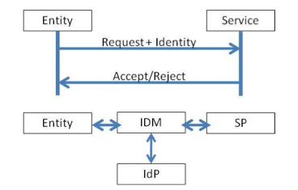
Minimize Loss of Control: IDM Motivation-Authentication Process using PII
Problem: Which information to disclose and how to disclose it.

Slide 21
Proposed IDM: Mechanisms
[16] Protection of Identity Information in Cloud Computing without Trusted Third Party - R. Ranchal, B. Bhargava, L.B. Othmane, L. Lilien, A. Kim, M. Kang, Third International Workshop on Dependable Network Computing and Mobile Systems (DNCMS) in conjunction with 29th IEEE Symposium on Reliable Distributed System (SRDS) 2010
[17] A User-Centric Approach for Privacy and Identity Management in Cloud Computing - P. Angin, B. Bhargava, R. Ranchal, N. Singh, L. Lilien, L.B. Othmane 29th IEEE Symposium on Reliable Distributed System (SRDS) 2010
Privacy in Cloud Computing Through Identity Management - B. Bhargava, N. Singh, A. Sinclair, International Conference on Advances in Computing and Communication ICACC-11, April, 2011, India.
Active Bundle
Anonymous Identification
Computing Predicates with encrypted data
Multi-Party Computing
Selective Disclosure

Slide 22
Proposed IDM: Active Bundle
Active bundle (AB)
An encapsulating mechanism protecting data carried within it
Includes data
Includes metadata used for managing confidentiality
Both privacy of data and privacy of the whole AB
Includes Virtual Machine (VM)
performing a set of operations
protecting its confidentiality

Slide 23
Proposed IDM: Active Bundle (Cont.)
Active Bundles—Operations
Self-Integrity check
E.g., Uses a hash function
Evaporation/ Filtering
Self-destroys (a part of) AB’s sensitive data when threatened with a disclosure
Apoptosis
Self-destructs AB’s completely

Slide 24
Proposed IDM: Active Bundle Scheme
Metadata:
Access control policies
Data integrity checks
Dissemination policies
Life duration
ID of a trust server
ID of a security server
App-dependent information
…
E(Name)
E(E-mail)
E(Password)
E(Shipping Address)
E(Billing Address)
E(Credit Card)
…
Sensitive Data:
Identity Information
...
Virtual Machine (algorithm):
Interprets metadata
Checks active bundle integrity
Enforces access and dissemination control policies
…
* E( ) - Encrypted Information

Slide 25
Proposed IDM: Anonymous Identification
Use of Zero-knowledge proofing for user authentication without disclosing its identifier.
User on Amazon Cloud
ZKP Interactive Protocol
User Request for service
Function f and number k
E-mail
Password
f_{k}(E-mail, Password) = R
E-mail
Password
Authenticated

Slide 26














Proposed IDM: Interaction using Active Bundle
AB information disclosure
Active Bundle Destination
User Application
Active Bundle
Active Bundle Creator
Active
Bundle (AB)
Security Services
Agent (SSA)
Audit Services
Agent (ASA)
Directory
Facilitator
Trust Evaluation
Agent (TEA)
Active Bundle Coordinator
Active Bundle Services

Slide 27
Proposed IDM: Predicate over Encrypted Data
Verification without disclosing unencrypted identity data.
Predicate Request*
E-mail
Password
E(Name)
E(Shipping Address)
E(Billing Address)
E(Credit Card)
E(Name)
E(Billing Address)
E(Credit Card)
*Age Verification Request
*Credit Card Verification Request

Slide 28
Proposed IDM: Multi-Party Computing
To become independent of a trusted third party
Multiple Services hold shares of the secret key
Minimize the risk
Predicate Request
E(Name)
E(Billing Address)
E(Credit Card)
K’₁
K’₂
K’₃
K’_{n}
Key Management Services
* Decryption of information is handled by the Key Management services

Slide 29
Proposed IDM: Multi-Party Computing
To become independent of a trusted third party
Multiple Services hold shares of the secret key
Minimize the risk
Predicate Reply*
Name
Billing Address
Credit Card
K’₁
K’₂
K’₃
K’_{n}
Key Management Services
*Age Verified
*Credit Card Verified

Slide 30
Proposed IDM: Selective Disclosure
User Policies in the Active Bundle dictate dissemination
Selective disclosure*
E-mail
Password
E(Name)
E(Shipping Address)
E(Billing Address)
E(Credit Card)
E(E-mail)
E(Name)
E(Shipping Address)
*e-bay shares the encrypted information based on the user policy

Slide 31
Proposed IDM: Selective Disclosure
User Policies in the Active Bundle dictate dissemination
Selective disclosure*
E-mail
Password
E(Name)
E(Shipping Address)
E(Billing Address)
E(Credit Card)
E-mail
E(Name)
E(Shipping Address)
Decryption handled by Multi-Party Computing as in the previous slides

Slide 32
Proposed IDM: Selective Disclosure
Selective disclosure*
E-mail
E(Name)
E(Shipping Address)
E(Name)
E(Shipping Address)
*e-bay seller shares the encrypted information based on the user policy

Slide 33
Proposed IDM: Selective Disclosure
Selective disclosure
E-mail
E(Name)
E(Shipping Address)
Name
Shipping Address
Decryption handled by Multi-Party Computing as in the previous slides

Slide 34


Proposed IDM: Selective Disclosure
Selective disclosure
E-mail
E(Name)
E(Shipping Address)
Name
Shipping Address
Fed-Ex can now send the package to the user

Slide 35
Proposed IDM: Identity in the Cloud
User on Amazon Cloud
E-mail
Password
Name
Billing Address
Credit Card
Name
E-mail
Password
Billing Address
Shipping Address
Credit Card
E-mail
Name
Shipping Address

Slide 36
Proposed IDM: Characteristics and Advantages
Ability to use Identity data on untrusted hosts
Self Integrity Check
Integrity compromised- apoptosis or evaporation
Data should not be on this host
Independent of Third Party
Prevents correlation attacks
Establishes the trust of users in IDM
Through putting the user in control of who has his data
Identity is being used in the process of authentication, negotiation, and data exchange.
Minimal disclosure to the SP
SP receives only necessary information.

Slide 37
Proposed IDM: Conclusion & Future Work
Problems with IDM in Cloud Computing
Collusion of Identity Information
Prohibited Untrusted Hosts
Usage of Trusted Third Party
Proposed Approaches
IDM based on Anonymous Identification
IDM based on Predicate over Encrypted data
Future work
Develop the prototype, conduct experiments and evaluate the approach

Slide 38
Minimize Multi-tenancy

Slide 39
Minimize Multi-tenancy
Can’t really force the provider to accept less tenants
Can try to increase isolation between tenants
Strong isolation techniques (VPC to some degree)
C.f. VM Side channel attacks (T. Ristenpart et al.)
QoS requirements need to be met
Policy specification
Can try to increase trust in the tenants
Who’s the insider, where’s the security boundary? Who can I trust?
Use SLAs to enforce trusted behavior

Slide 40
Conclusion
Cloud computing is sometimes viewed as a reincarnation of the classic mainframe client-server model
However, resources are ubiquitous, scalable, highly virtualized
Contains all the traditional threats, as well as new ones
In developing solutions to cloud computing security issues it may be helpful to identify the problems and approaches in terms of
Loss of control
Lack of trust
Multi-tenancy problems

Slide 41
CLOUD COMPUTING FOR MOBILE USERS: CAN OFFLOADING COMPUTATION SAVE ENERGY?

Slide 42
What cloud gives us, generally
Take Amazon cloud for example.
store personal data
(Simple Storage Service (S3) )
perform computations on stored data
(Elastic Compute Cloud (EC2). )
Notes:
你好

Slide 43
What cloud gives us, generally
If you want to set up a business.
low initial capital investment
shorter start-up time for new services
lower maintenance and operation costs
higher utilization through virtualization
easier disaster recovery

Slide 44
What about cloud computing for mobile users? Specifically
Two main concerns:
mobile computing are limited energy
wireless bandwidth

Slide 45
The importance of battery lifetime of mobile phones
Various studies have identified longer battery
lifetime as the most desired feature of such
systems.
longer battery life to be more important than all other features, including cameras or storage.
short battery life to be the most disliked characteristic of Apple’s iPhone 3GS
battery life was the top concern of music phone users.

Slide 46
Four basic approaches to saving energy and extending battery lifetime in mobile devices:
Adopt a new generation of semiconductor technology.
Avoid wasting energy. (when it is idle, sleep mode)
Execute programs slowly. (When a processor’s clock speed doubles, the power consumption nearly octuples).
Eliminate computation all together. (offloading these applications to the cloud).

Slide 47

Can offloading these applications to the cloud save energy and extend battery lifetimes for mobile users?
How to implement a quantitative study. The amount of energy saved is
S : the speed of cloud to compute C instructions
M : the speed of mobile to compute C instructions
D : the data need to transmit
B : the bandwidth of the wireless Internet

Slide 48
Can offloading these applications to the cloud save energy and extend battery lifetimes for mobile users?
the energy cost per second when the mobile phone is doing computing
the energy cost per second when the mobile phone is idle.
the energy cost per second when the mobile is transmission the data.

Slide 49

Can offloading these applications to the cloud save energy and extend battery lifetimes for mobile users?
Suppose the server is F times faster—that is, S
= F × M. We can rewrite the formula as
Energy is saved when this formula produces a
positive number. The formula is positive if D/B
is sufficiently small compared with C/M and F
is sufficiently large.

Slide 50
sample applications benefiting from offloading
chess game.
A chessboard has 8 × 8 = 64 positions. Each
player controls 16 pieces at the beginning of
the game. Each piece may be in one of the 64
possible locations and needs 6 bits to
represent the location. To represent a chess
game’s current state, it is sufficient to state
that 6 bits × 32 pieces = 192 bits = 24 bytes;
this is smaller than the size of a typical
wireless packet.

Slide 51
sample applications benefiting from offloading
The amount of computation for chess is very
large; Claude Shannon and Victor Allis
estimated the complexity of chess to exceed
the number of atoms in the universe. Since the
amount of computation C is extremely large,
and D is very small, chess provides an example
where offloading is beneficial for most wireless
networks.

Slide 52
sample applications not benefiting from offloading
regions like national parks
the basement of a building
interior of a tunnel,
subway.
In these cases,
where the value of B in Equation can become
very small or even zero, cloud computing does
not save energy.

Slide 53
Making computation offloading more attractive
There is a fundamental assumption
under-lying this analysis with the client-server
model: Because the server does not already
contain the data, all the data must be sent to
the service provider.
However, cloud computing changes that
assumption: The cloud stores data and performs
computation on it. For example, services like
Amazon S3 can store data, and Amazon EC2 can
be used to perform computation on the data
stored using S3.

Slide 54
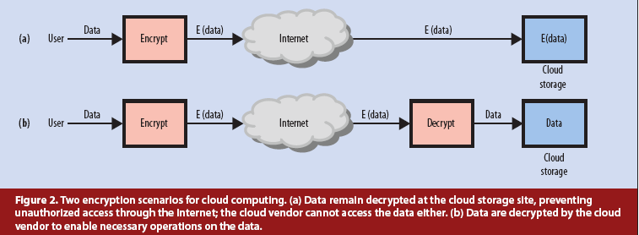
When considering Privacy and security

Slide 55
When considering Privacy and security
Another possible privacy and security solution
is to use a technique called steganography :
Multimedia content like images and videos
have significant redundancy. This makes it
possible to hide data in multimedia using
steganography.
Steganographic techniques can be used to
transform the data before storage so that
operations can still be performed on the data.

Slide 56
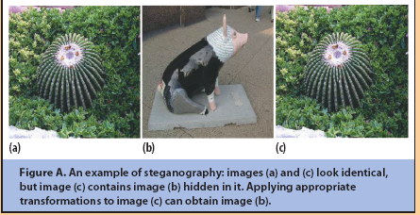
When considering Privacy and security

Slide 57

When considering Privacy and security
Performing encryption or steganographic
techniques before sending data to the cloud
requires some additional processing on the
mobile system. So the formula become:

Slide 58
Conclusion
cloud computing can potentially save energy
for mobile users.
not all applications are energy
efficient when migrated to the cloud.
cloud computing services would be
significantly different from cloud services for
desktops because they must offer energy
savings.
The services should consider the energy
overhead for privacy, security, reliability,
and data communication before offloading.

Slide 59
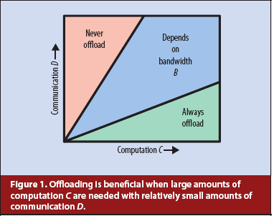
Conclusion

Slide 60
Bandwidth Measurements for VMs in Cloud

Slide 61
MOTIVATION
Many applications are being deployed in cloud to leverage the scalability provided by the cloud providers.
Tools provided by the cloud providers do not give performance metrics from the network perspective.
Network topology is not exposed to the cloud users and the applications consider all network links to be homogeneous.
Metrics such as available bandwidth, latency etc. will be more useful to the cloud users.

Slide 62
Experimental Evaluation
Set up
19 EC2 small instances (US East)
342 links between VMs
Ubuntu 10.04 server version
Centralized Scheduler for starting Iperf clients
Predefined serialized schedule file at each VM instance.
Schedule file contains a time stamp along with the nodes that should communicate for a single reading.
* Iperf - Network testing tool to measure the network
throughput between end hosts.

Slide 63
Experimental Evaluation
Iperf takes 6 seconds to get a reading for a single link.
Each round of measurement takes around 30 minutes for finding available bandwidth for all 342 links.
Total 5 rounds in total
Throughput matrix: Matrix containing estimated values for available bandwidth

Slide 64
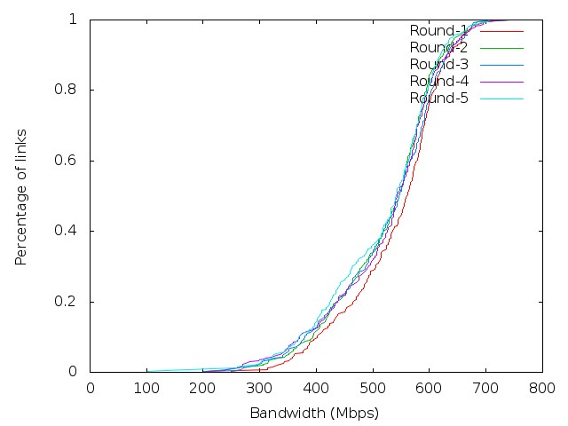
Bandwidth Estimation
Shows the CDF of link bandwidth estimation for all the rounds.
Used throughput matrix having estimated 342 values.
All links in clouds are not homogeneous.
Only 10% of the links have available bandwidth less than 400Mbps.

Slide 65
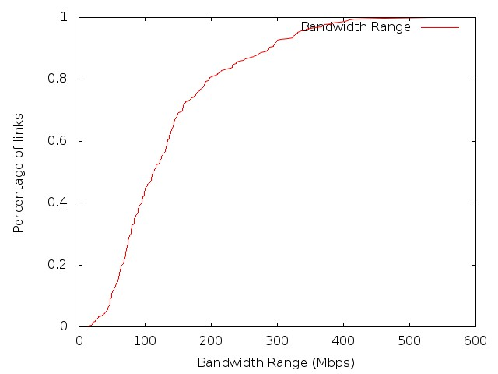
Bandwidth Variation Estimation
Shows the CDF of link bandwidth variation across all the rounds.
Bandwidth range of a link defined as the difference between the max and min value across all rounds.
For most of the links, bandwidth is consistent across time. Only 20% links have variation of more than 200 Mbps.

Slide 66
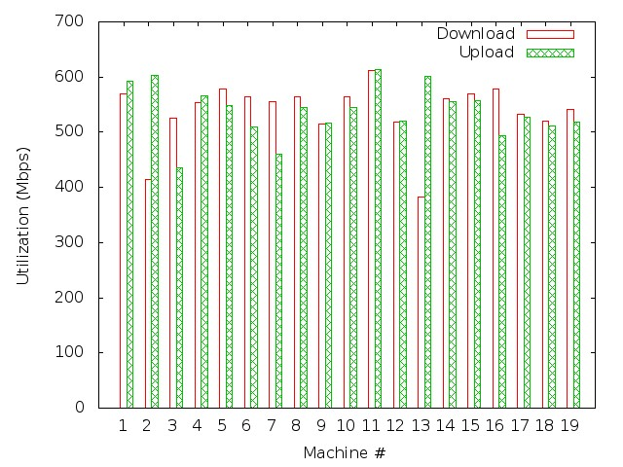
Virtual Machine Performance
Shows the available download/upload bandwidth of all machines for a single round
Almost all the machines have average available bandwidth more than 400 Mbps.

Slide 67
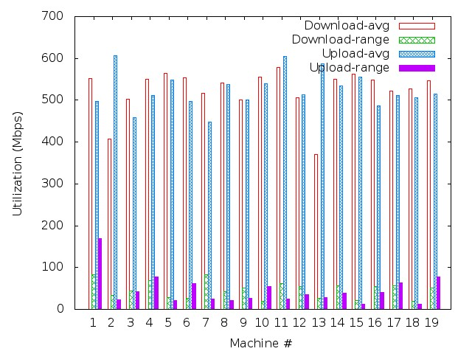
Virtual Machine Performance
Shows the average available download/ upload bandwidth and its range for each machine across all rounds.
Almost all the machines have average download/ upload bandwidth more than 400 Mbps.
Some VMs (1, 4, 7) have large available bandwidth variation.

Slide 68
CONCLUSIONS
Focussed on available bandwidth metric between each pair of VM instances.
Amazon EC2 data center is optimally utilized with ample available bandwidth for almost all VMs.
Some badly performing VMs can be pointed out based on the large variation in the available upload/download bandwidth and can be replaced with new VMs.

Slide 69
Future Work
More performance metric such as latency etc. can be considered.
These performance metrics can be used to improve the performance of applications running in the cloud.
These performance metric tests can be run on large EC2 instances.

